Slide 1
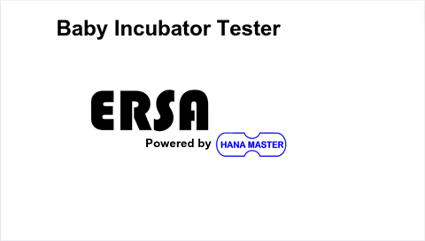

Slide 2
Baby Incubator Tester
Battery
95 %
13/05/2024
16:24:32
Setup
Temperature Monitoring
Air Speed and Sound Level
Wiring Guide
Temperature Trend
Radiant Warmer
Placement Guide

Slide 3
Baby Incubator Tester
Battery
95 %
13/05/2024
16:24:32
Setup
Temperature Monitoring
Air Speed and Sound Level
Wiring Guide
Temperature Trend
Radiant Warmer
Placement Guide

Slide 4



Baby Incubator Tester
Battery
95 %
13/05/2024
16:24:32
Temperature .
22.5 °C
22.9 °C
Humidity .
Max Temp 1: 24.5 °C
Max Temp 4: 24.6 °C
23.5 °C
23.4 °C
44.6 %
Max Temp 2: 24.1 °C
Max Temp 5: 24.8 °C
22.8 °C
22.9 °C
Max Temp 3: 23.3 °C
Max Temp 6: 23.5 °C

Slide 5
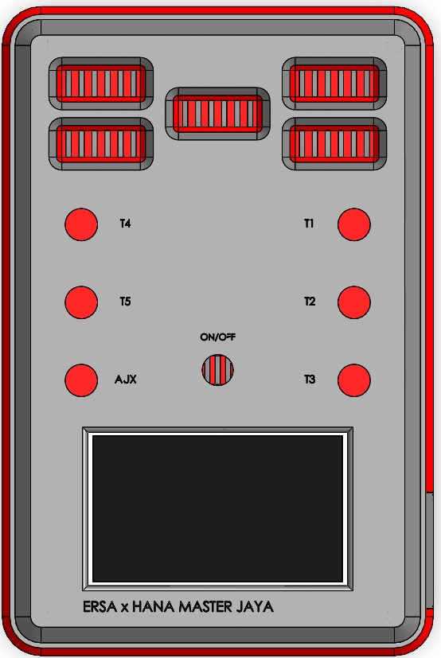
Baby Incubator Tester
Battery
95 %
13/05/2024
16:24:32
Placement Guide
T4
T1
T5
T2
AJX
T3
T1 – T5 = Temperature Sensors
AJX = Air speed and sound level
DC 12V In

Slide 6
Baby Incubator Tester
Battery
95 %
13/05/2024
16:24:32
Placement Guide
T4
T1
T5
T2
AJX
T3
T1 – T5 = Temperature Sensors
AJX = Air speed and sound level
DC 12V In

Slide 7
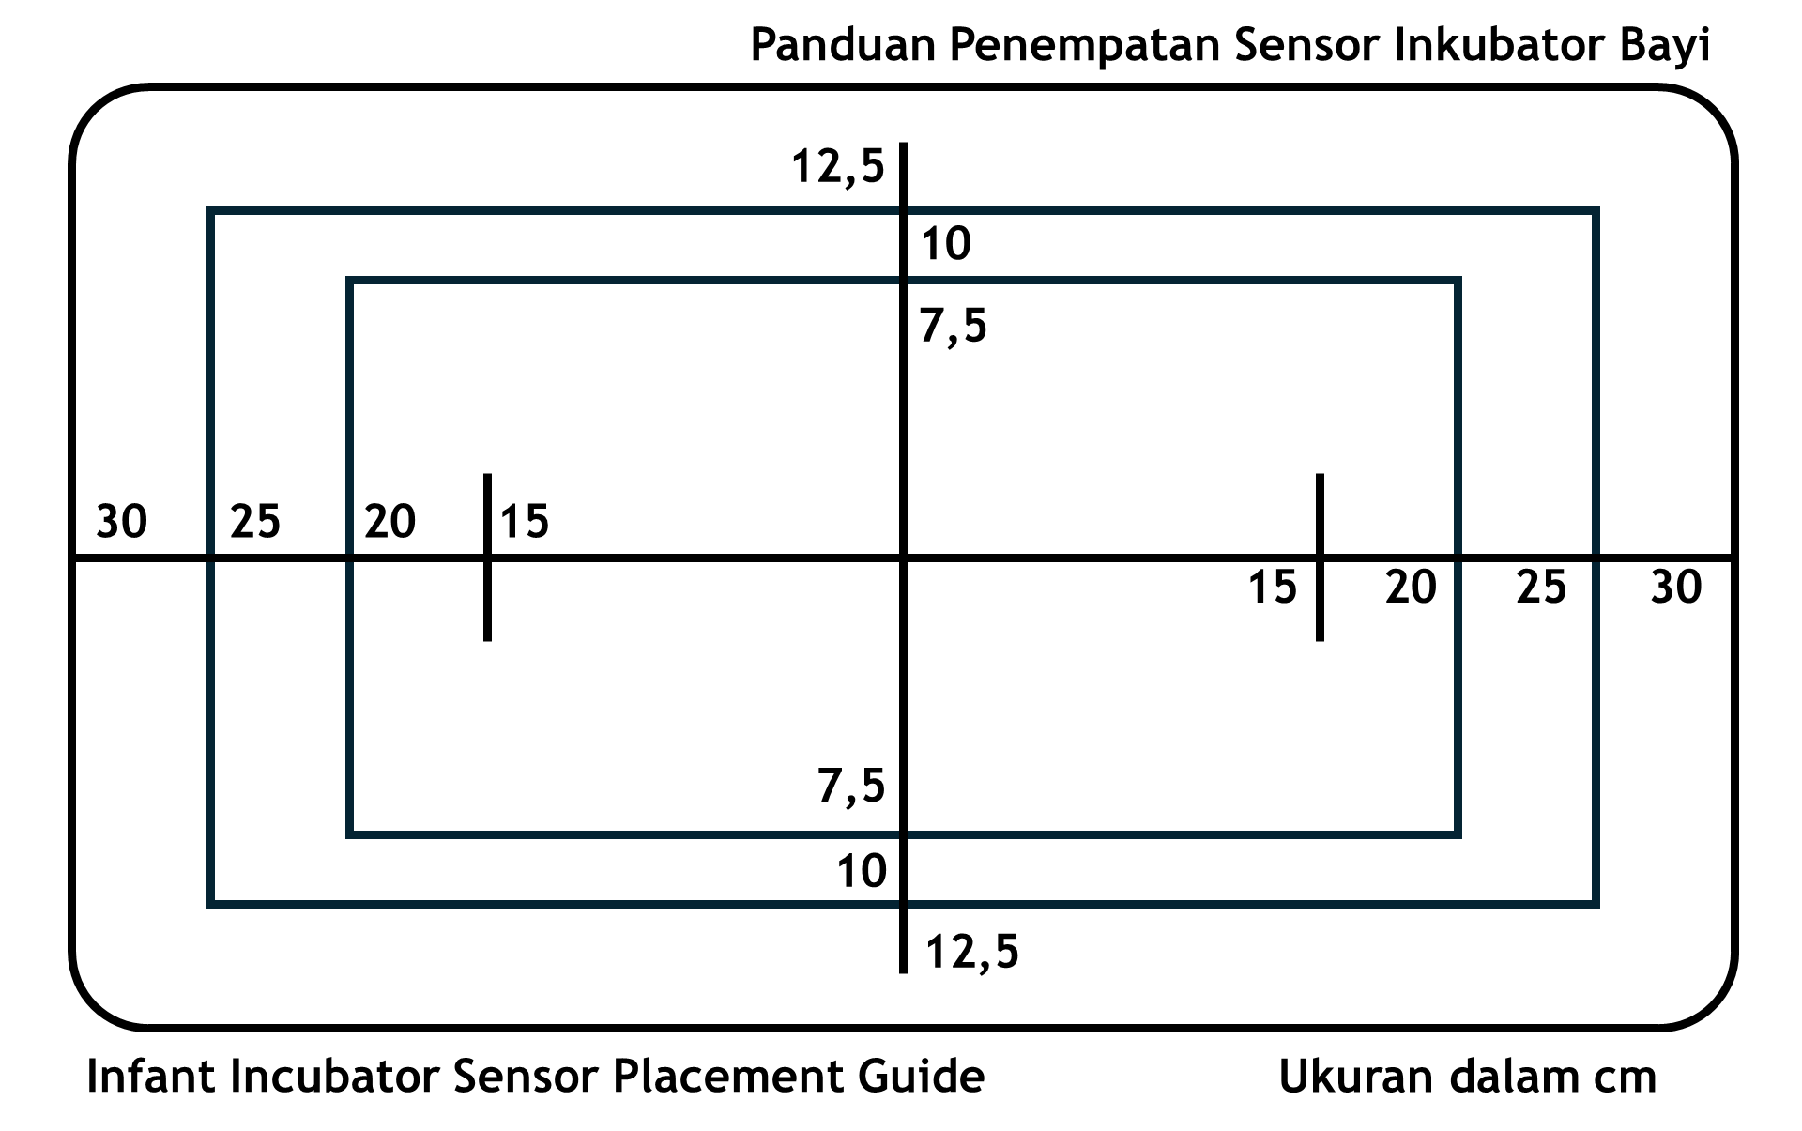
Baby Incubator Tester
Battery
95 %
13/05/2024
16:24:32
Wiring Guide

Slide 8
Baby Incubator Tester
Battery
95 %
13/05/2024
16:24:32
Wiring Guide

Slide 9


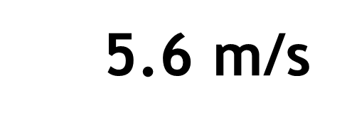
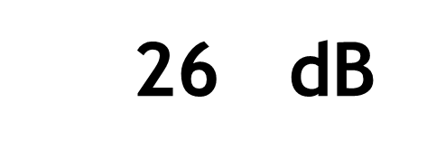
Baby Incubator Tester
Battery
95 %
13/05/2024
16:24:32
Air Speed
Sound Level
5.6 m/s
26 dB

Slide 10
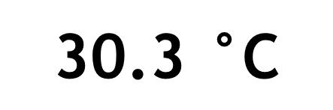
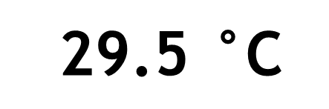
Baby Incubator Tester
Battery
95 %
13/05/2024
16:24:32
RADIANT WARMER MODE
Please connect Thermal Absorber sensor to T6!
Disk Temp
Max Temp
$\text{2}\text{9}\text{.5 }\text{°}\text{C}$
$$\text{ 30.3} \text{°}\text{C}$$

Slide 11






TEMPERATURE TREND
Real-Time
T1
T2
T3
T4
T5
T6
$$°\text{C}$$
$$°\text{C}$$
$$°\text{C}$$
$$°\text{C}$$
$$°\text{C}$$
$$°\text{C}$$
Clear
Pause
Resolution
1s
2s
4s
8s

Slide 12
TEMPERATURE TREND
Real-Time
T1
T2
T3
T4
T5
T6
$$°\text{C}$$
$$°\text{C}$$
$$°\text{C}$$
$$°\text{C}$$
$$°\text{C}$$
$$°\text{C}$$
Clear
Pause
Resolution
1s
2s
4s
8s

Slide 13
TEMPERATURE TREND
Real-Time
T1
T2
T3
T4
T5
T6
$$°\text{C}$$
$$°\text{C}$$
$$°\text{C}$$
$$°\text{C}$$
$$°\text{C}$$
$$°\text{C}$$
Clear
Pause
Resolution
1s
2s
4s
8s

Slide 14
TEMPERATURE TREND
Real-Time
T1
T2
T3
T4
T5
T6
$$°\text{C}$$
$$°\text{C}$$
$$°\text{C}$$
$$°\text{C}$$
$$°\text{C}$$
$$°\text{C}$$
Clear
Pause
Resolution
1s
2s
4s
8s

Slide 15
TEMPERATURE TREND
Real-Time
T1
T2
T3
T4
T5
T6
$$°\text{C}$$
$$°\text{C}$$
$$°\text{C}$$
$$°\text{C}$$
$$°\text{C}$$
$$°\text{C}$$
Clear
Resume
Resolution
1s
2s
4s
8s

Slide 16
TEMPERATURE TREND
Real-Time
T1
T2
T3
T4
T5
T6
$$°\text{C}$$
$$°\text{C}$$
$$°\text{C}$$
$$°\text{C}$$
$$°\text{C}$$
$$°\text{C}$$
Clear
Resume
Resolution
1s
2s
4s
8s

Slide 17
TEMPERATURE TREND
Real-Time
T1
T2
T3
T4
T5
T6
$$°\text{C}$$
$$°\text{C}$$
$$°\text{C}$$
$$°\text{C}$$
$$°\text{C}$$
$$°\text{C}$$
Clear
Resume
Resolution
1s
2s
4s
8s

Slide 18
TEMPERATURE TREND
Real-Time
T1
T2
T3
T4
T5
T6
$$°\text{C}$$
$$°\text{C}$$
$$°\text{C}$$
$$°\text{C}$$
$$°\text{C}$$
$$°\text{C}$$
Clear
Resume
Resolution
1s
2s
4s
8s

Slide 19
TEMPERATURE TREND
Real-Time
T1
T2
T3
T4
T5
T6
$$°\text{C}$$
Temperature trend will be cleared.
No data saved. Are you sure?
$$°\text{C}$$
$$°\text{C}$$
$$°\text{C}$$
Yes
No
$$°\text{C}$$
$$°\text{C}$$
Clear
Pause
Resolution
1s
2s
4s
8s

Slide 20
TEMPERATURE TREND
Real-Time
T1
T2
T3
T4
T5
T6
$$°\text{C}$$
Temperature trend will be cleared.
No data saved. Are you sure?
$$°\text{C}$$
$$°\text{C}$$
$$°\text{C}$$
Yes
No
$$°\text{C}$$
$$°\text{C}$$
Clear
Pause
Resolution
1s
2s
4s
8s

Slide 21
Baby Incubator Tester
Battery
95 %
13/05/2024
16:24:32
BRIGHTNESS
100 %
DATE AND TIME SETTINGS
13 / 05 / 2024
Change
16 : 24 : 32

Slide 22
Baby Incubator Tester
Battery
95 %
13/05/2024
16:24:32
BRIGHTNESS
100 %
DATE AND TIME SETTINGS
13 / 05 / 2024
<
>
Set
16 : 24 : 32
+
-

Slide 23
Baby Incubator Tester
Battery
95 %
13/05/2024
16:24:32
BRIGHTNESS
100 %
DATE AND TIME SETTINGS
13 / 05 / 2024
<
>
Set
16 : 24 : 32
+
-

Slide 24
Baby Incubator Tester
Battery
95 %
13/05/2024
16:24:32
BRIGHTNESS
100 %
DATE AND TIME SETTINGS
13 / 05 / 2024
<
>
Set
16 : 24 : 32
+
-

Slide 25
Baby Incubator Tester
Battery
95 %
13/05/2024
16:24:32
BRIGHTNESS
100 %
DATE AND TIME SETTINGS
13 / 05 / 2024
<
>
Set
16 : 24 : 32
+
-

Slide 26
Baby Incubator Tester
Battery
95 %
13/05/2024
16:24:32
BRIGHTNESS
100 %
DATE AND TIME SETTINGS
13 / 05 / 2024
<
>
Set
16 : 24 : 32
+
-

Slide 27
Baby Incubator Tester
Battery
95 %
13/05/2024
16:24:32
BRIGHTNESS
100 %
DATE AND TIME SETTINGS
13 / 05 / 2024
<
>
Set
16 : 24 : 32
+
-

Slide 28
Baby Incubator Tester
Battery
95 %
13/05/2024
16:24:32
BRIGHTNESS
100 %
DATE AND TIME SETTINGS
13 / 05 / 2024
<
>
Set
16 : 24 : 32
+
-

Slide 29
Panduan Penempatan Sensor Inkubator Bayi
12,5
10
7,5
30
25
20
15
15
20
25
30
7,5
10
12,5
Infant Incubator Sensor Placement Guide
Ukuran dalam cm

Slide 30
